Slide 1
Travaux Pratiques

Slide 2
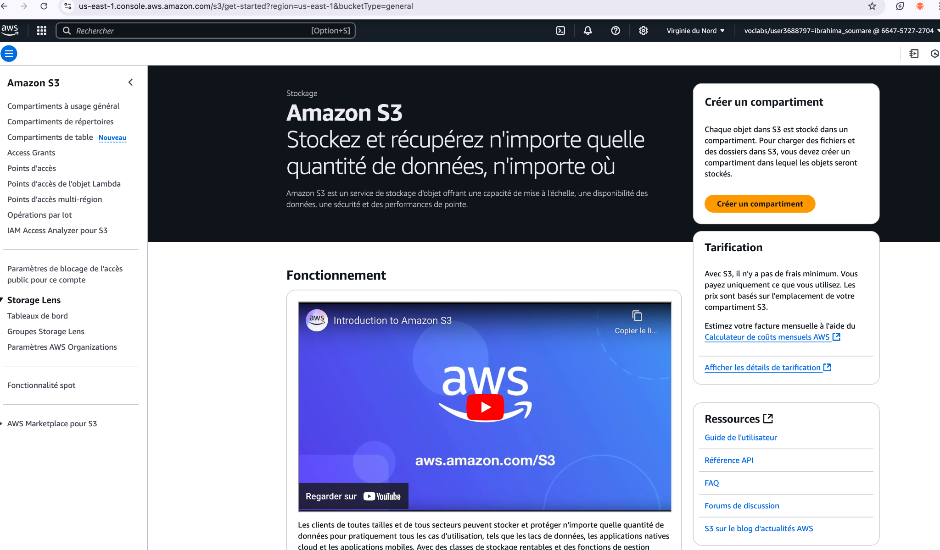

Slide 3
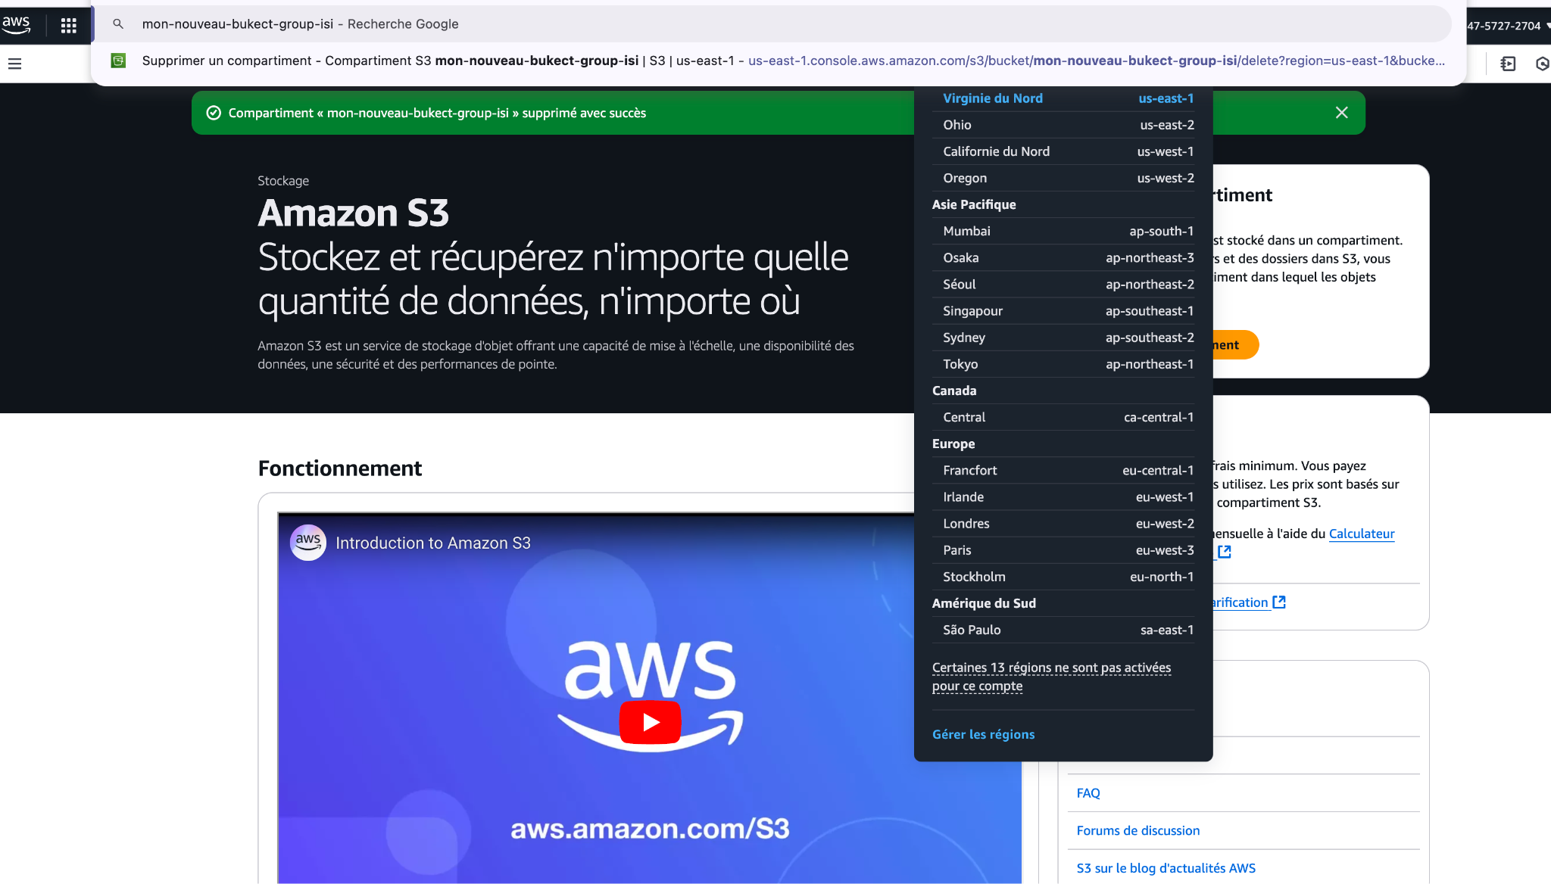

Slide 4
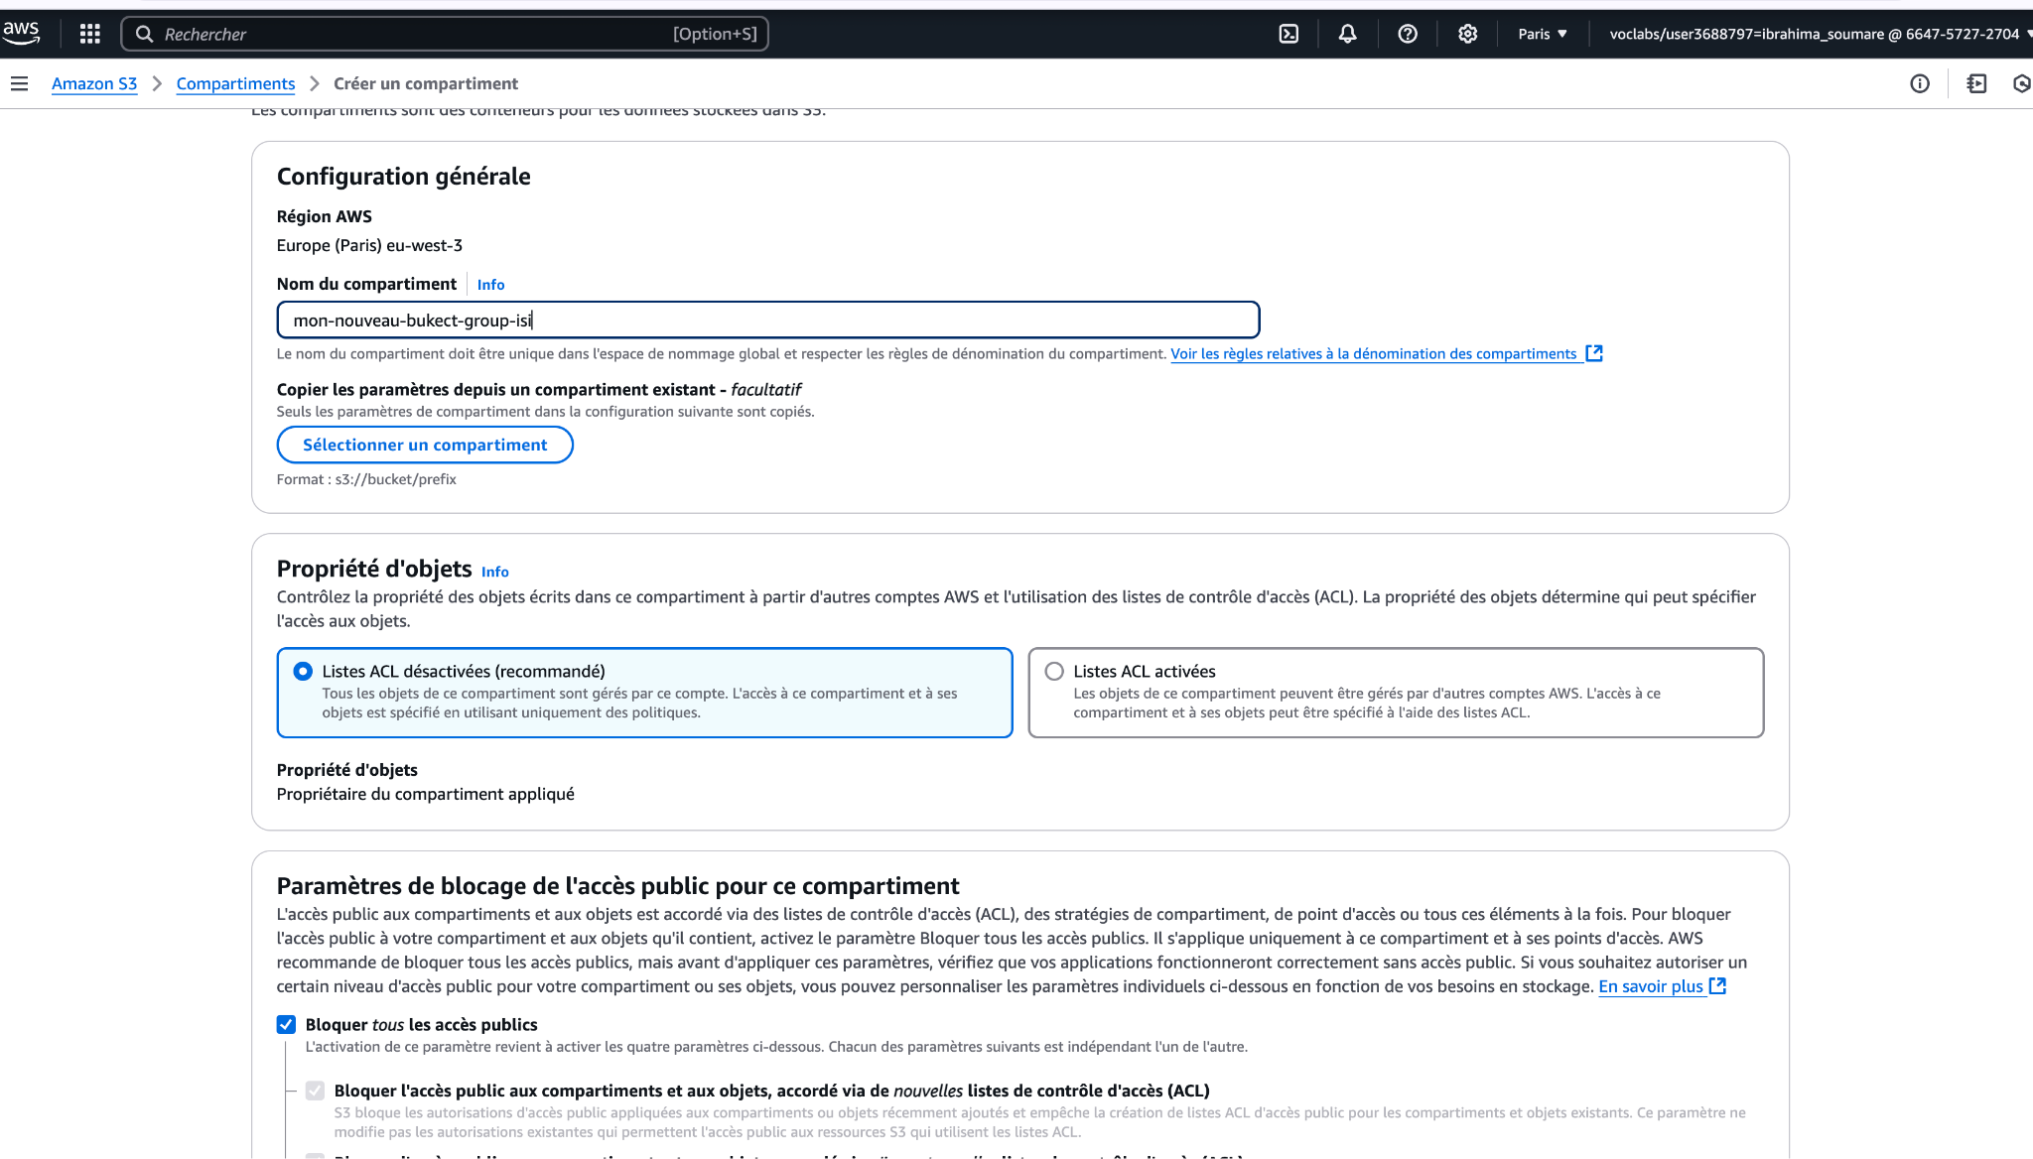

Slide 5
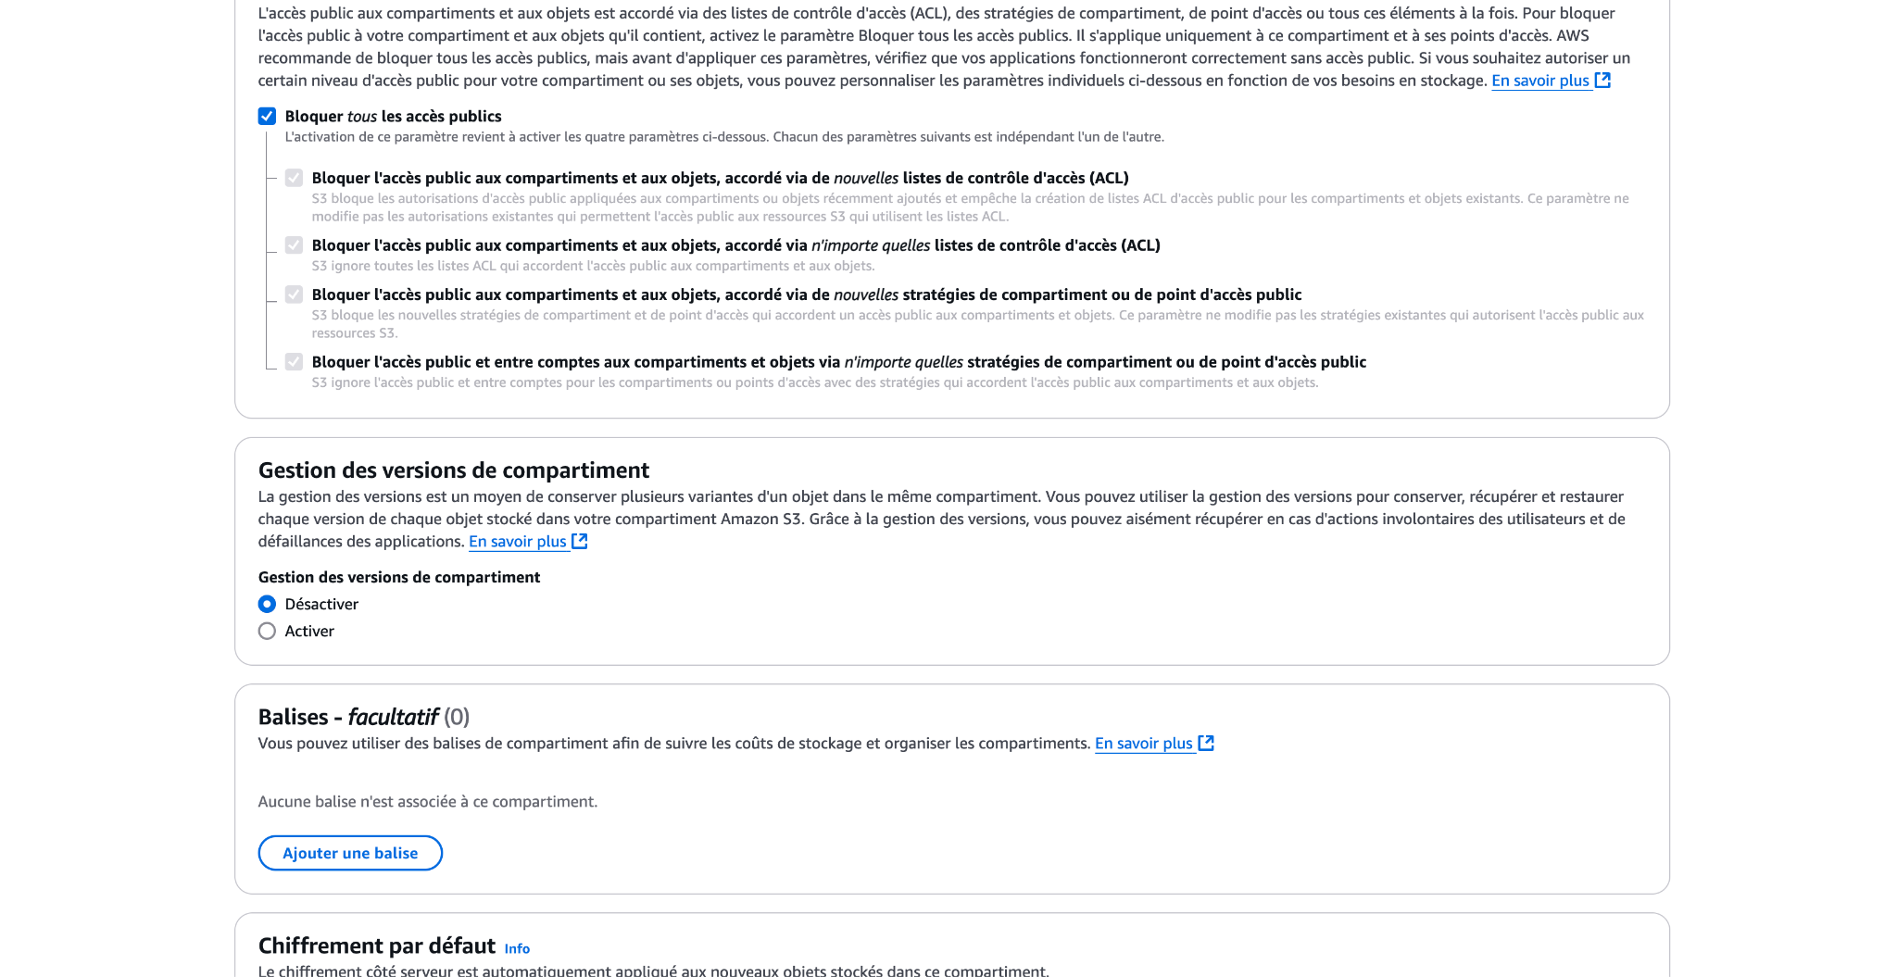

Slide 6
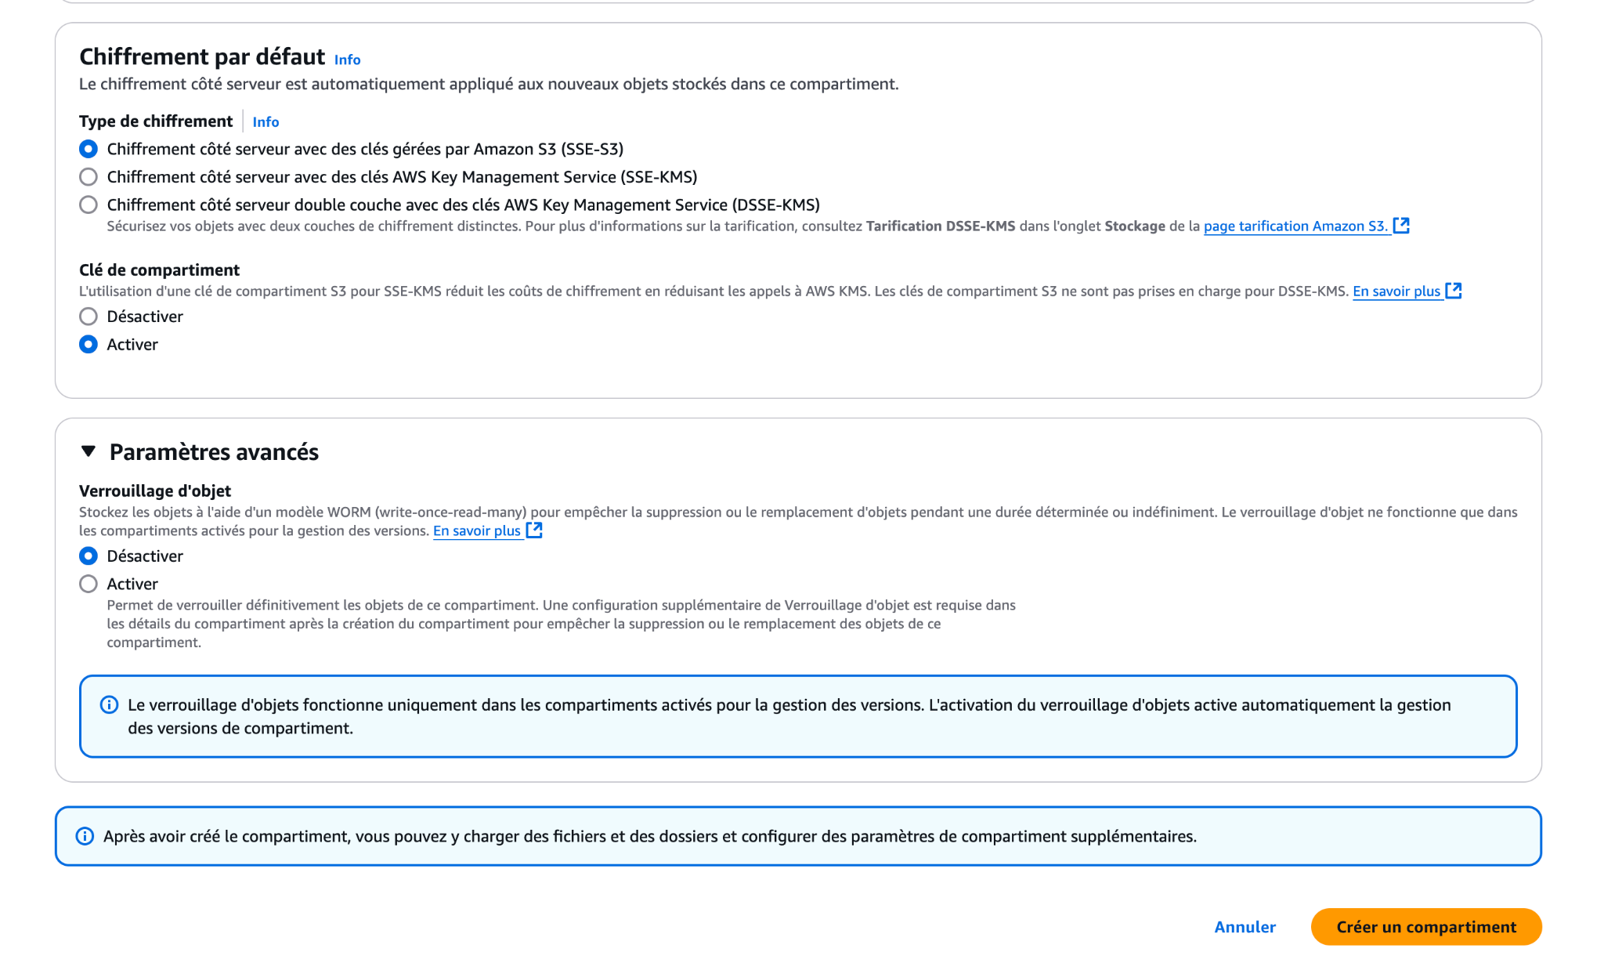

Slide 7
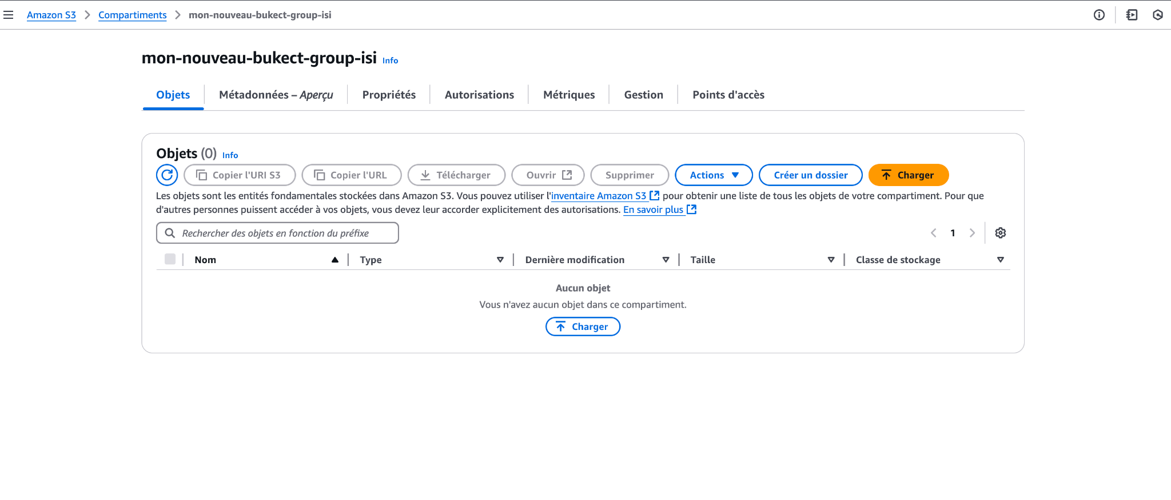

Slide 8
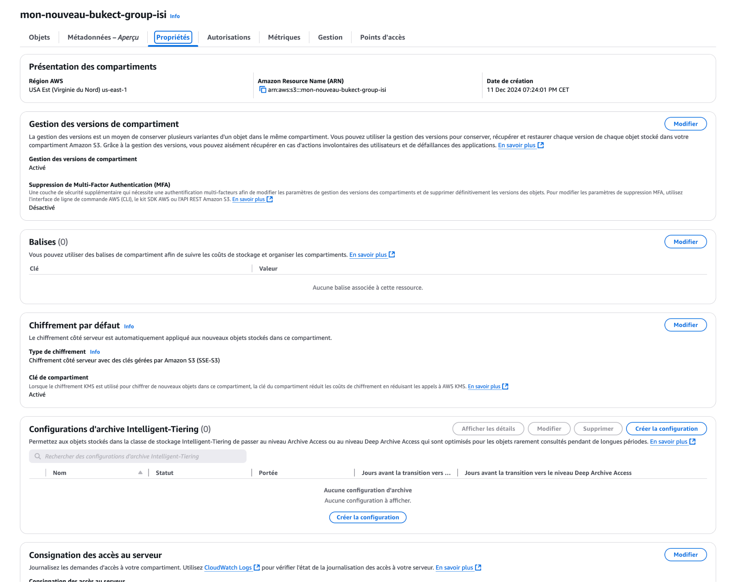

Slide 9
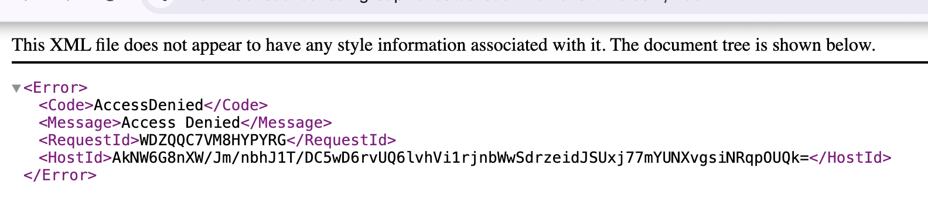
Lien Github
{
"Version": "2012-10-17",
"Id": "MyBucketPolicy",
"Statement": [
{
"Sid": "GetWebSite",
"Effect": "Allow",
"Principal": "*",
"Action": "s3:GetObject",
"Resource": "arn:aws:s3:::mon-nouveau-bukect-group-isi/*"
}
]
}

Slide 10
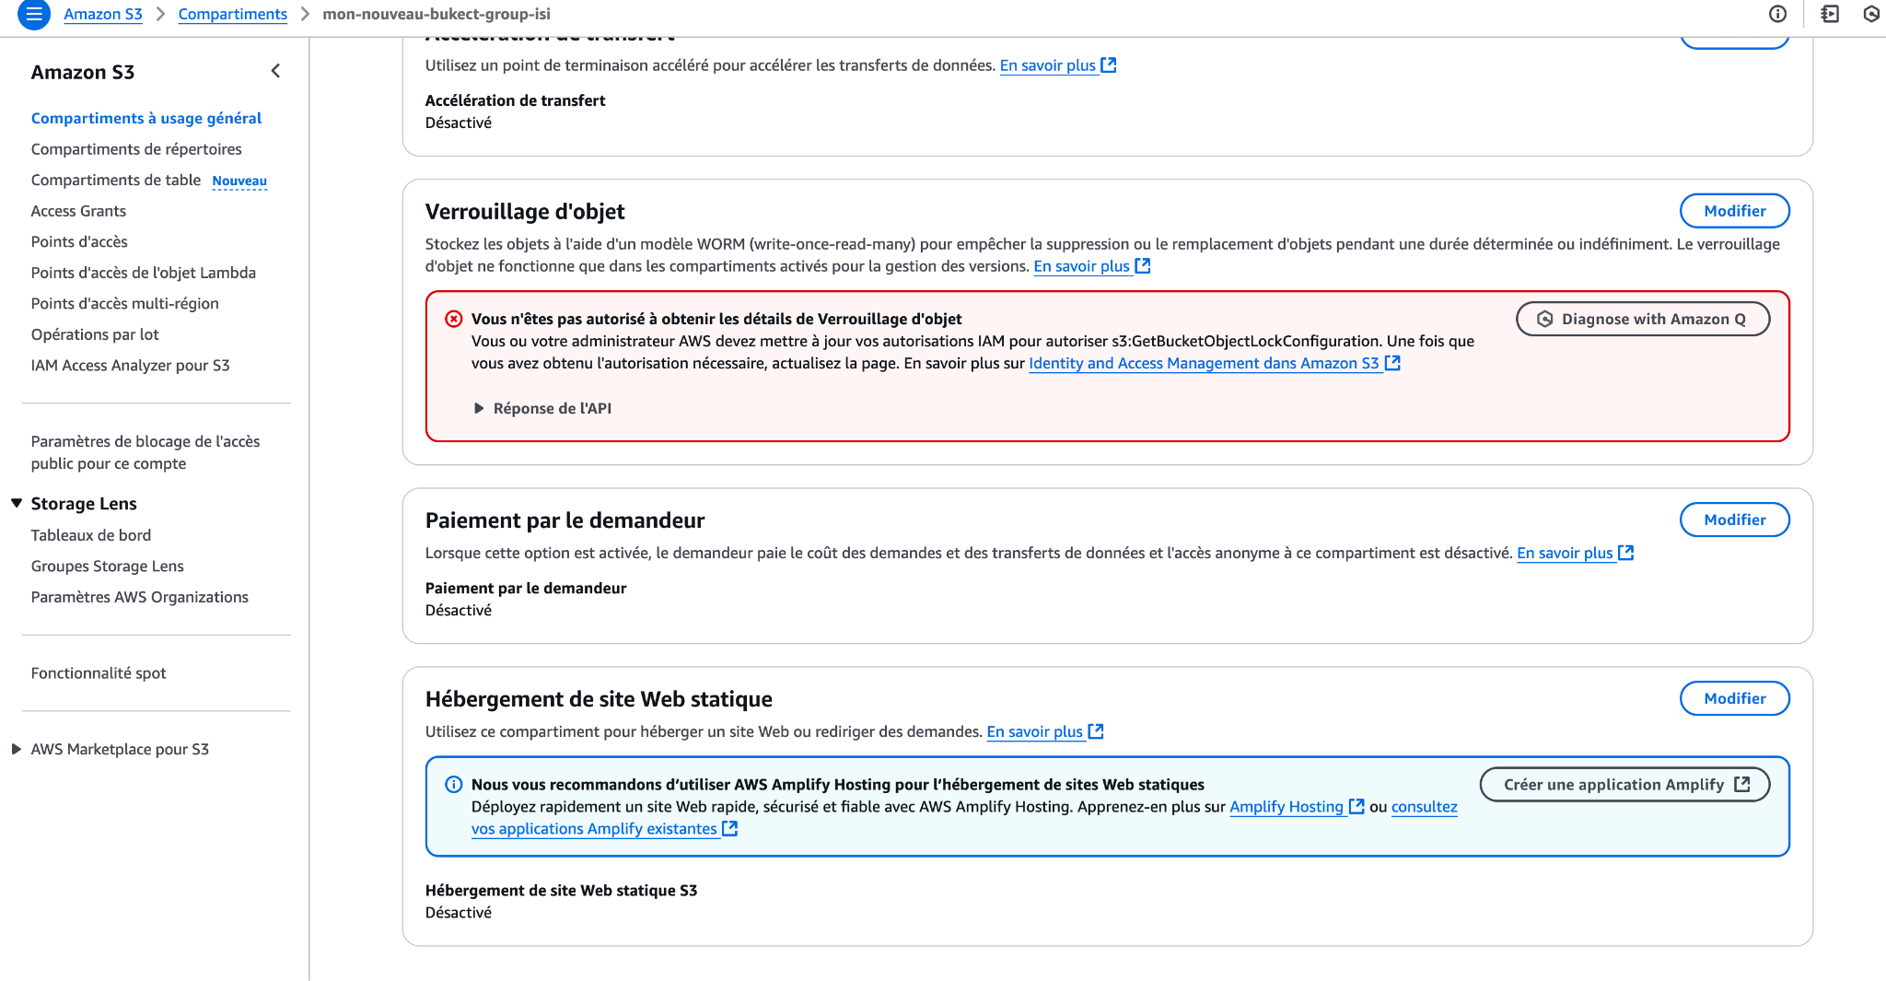

Slide 11
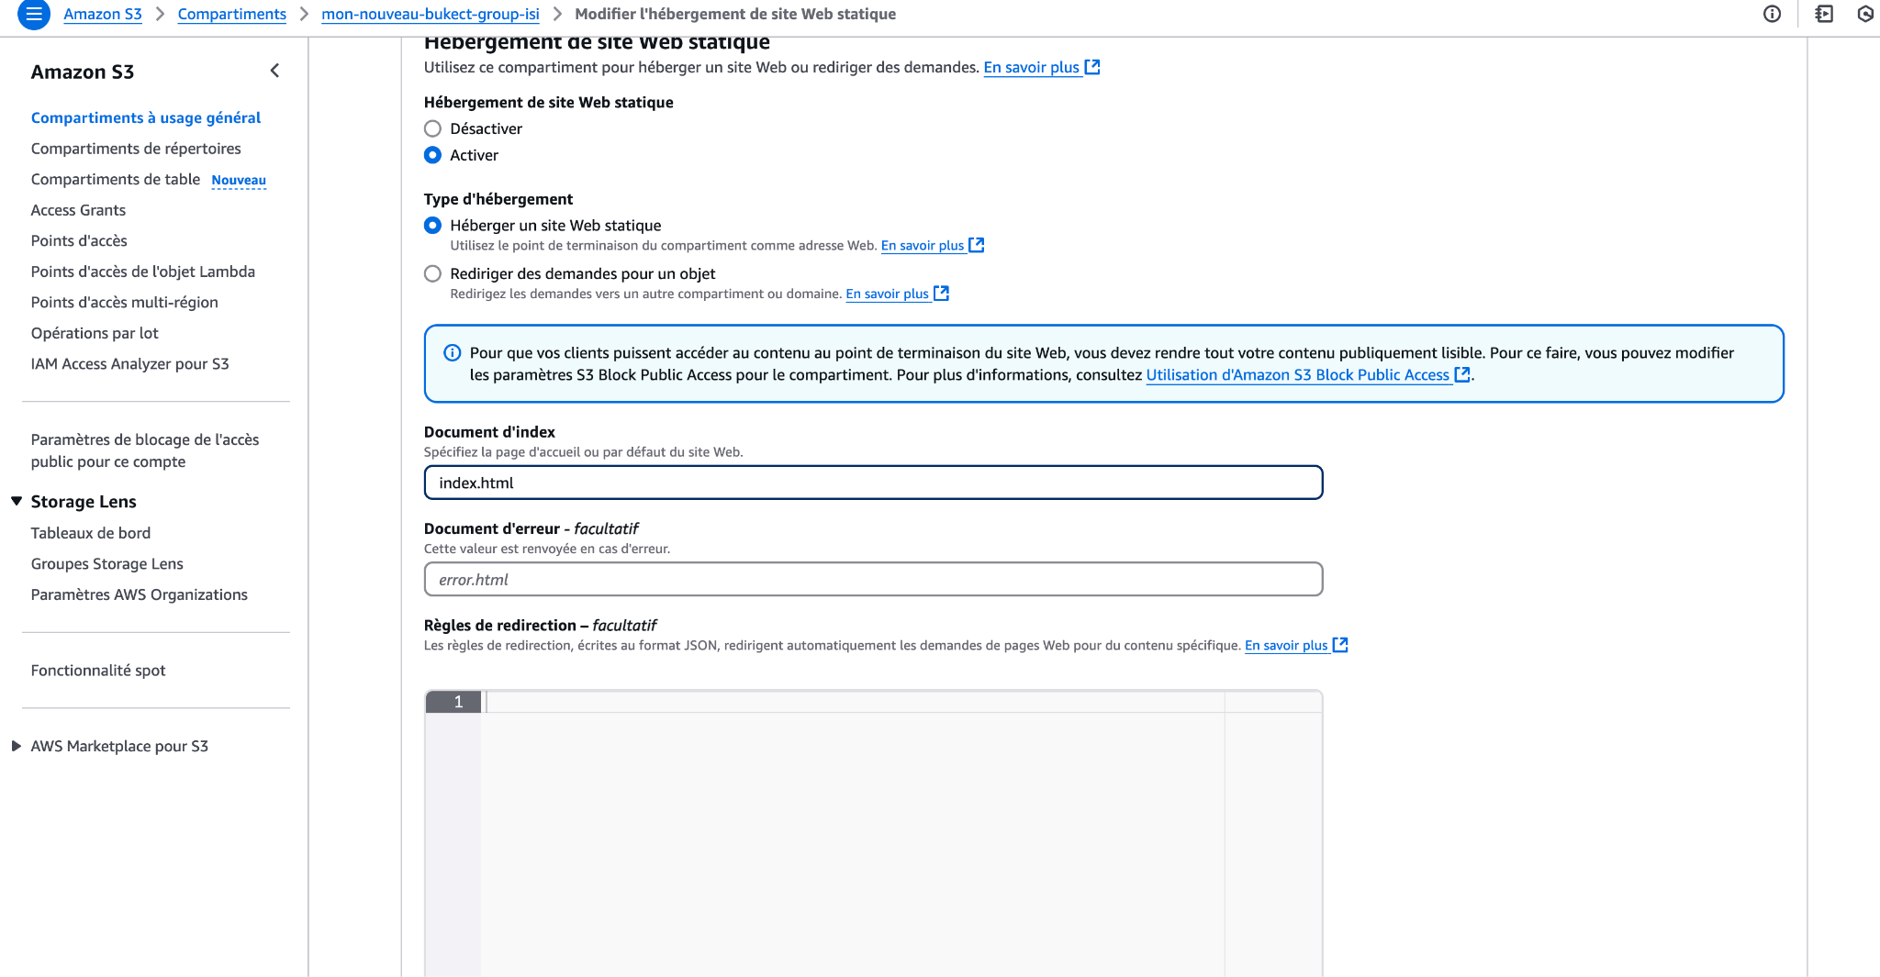

Slide 12
